Slide 1
Course No: MSE 4200
Synthesis and Characterization of Yttrium Doped, and Undoped Zinc Oxide Thin Film by Spin Coating
Group No: 13
Group Members:
Supervised by:
S.M. Nasim Rokon
Dept. of Materials Science & Eng.
RUET
Maruf Ahmed (1713028)
Rahik Ibne Forman(1713029)

Slide 2
Outline
Motivation
Introduction
Literature review
Research gap
Objectives
Methodology
XRD
SEM
EDS
UV Spectroscopy
Conclusions
Recommendations

Slide 3
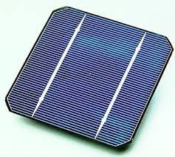
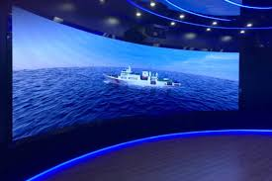


Motivation
Optoelectronics
LEDs [1]
Solar Cells [2]
Sensors
Gas sensors [3]
Piezoelectric sensors [4]

Slide 4
Literature Review
Year of Publication | Author’s Name | Title | Methods used | Type of works
2005 | Ravinder Kaur, A., V. Singh, and R., M. Mehra | Structural, electrical and optical properties of sol–gel derived yttrium doped ZnO films | Sol gel, dip-coating | annealing temperature and film thickness dependence
2007 | Qingjiang Yu1, Wuyou Fu1, Cuiling Yu1, Haibin Yang1,3, | Structural, electrical and optical properties of yttrium-doped ZnO thin films prepared by sol–gel method | Sol gel | Analysis of the structural, electrical and optical properties.
2015 | Sanjeev Kumar Sharma, D.V.N. Sudheer Pamidimarri, Deuk Young Kim | Y-doped zinc oxide (YZO) nanoflowers, microstructural analysis and test their antibacterial activity | Hydrothermal-precipitation | self-assembled 3D flower-like YZO composed of nanorods
2015 | O. Bazta, A. Urbieta, J. Piqueras, P. Fernández, M. Addou | Influence of yttrium doping on the structural, morphological and optical properties of nanostructured ZnO thin films grown by spray pyrolysis | spray pyrolysis | structural, morphological, and optical properties

Slide 5
Research Gap
Dopants and interfaces
Low-scale Productivity
Research Gap
Lack of long-term stability
Performance on elevated temperature

Slide 6
Objectives
To determine the change of crystallite sizes by the Yttrium doping in ZnO.
To analysis the changes in band structure by Yttrium doping.

Slide 7
Introduction
Benefits of Zinc Oxide Thin Film
Low Cost
Low cost in comparison to other sources
Moderate Control of properties
Common Formation methods
By doping, annealing, changing thickness etc.
Common formation methos by several deposition techniques
Good Properties
Zinc oxide thin film
Fields of developments
Optoelectronics, electrical, sensing properties
Has broad scope in semiconductor technology

Slide 8
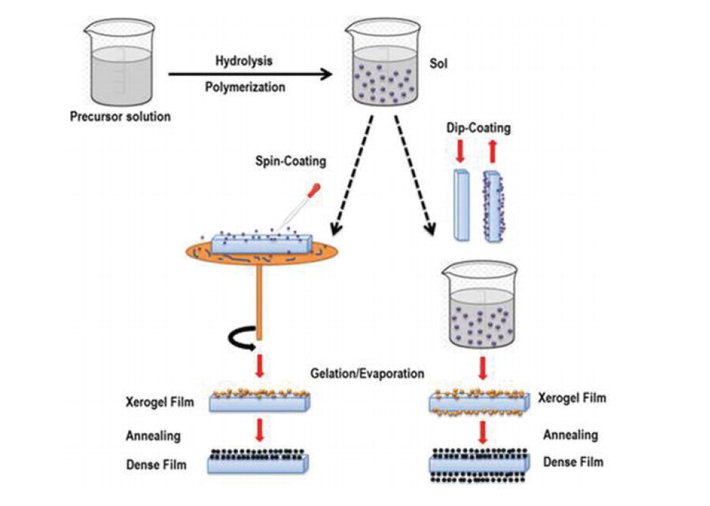
Methodology
Weighing
Mixing
Stirring
Glass Preparation
Annealing
Drying
Spin Coating
Fig. 1: Methodology Overview

Slide 9
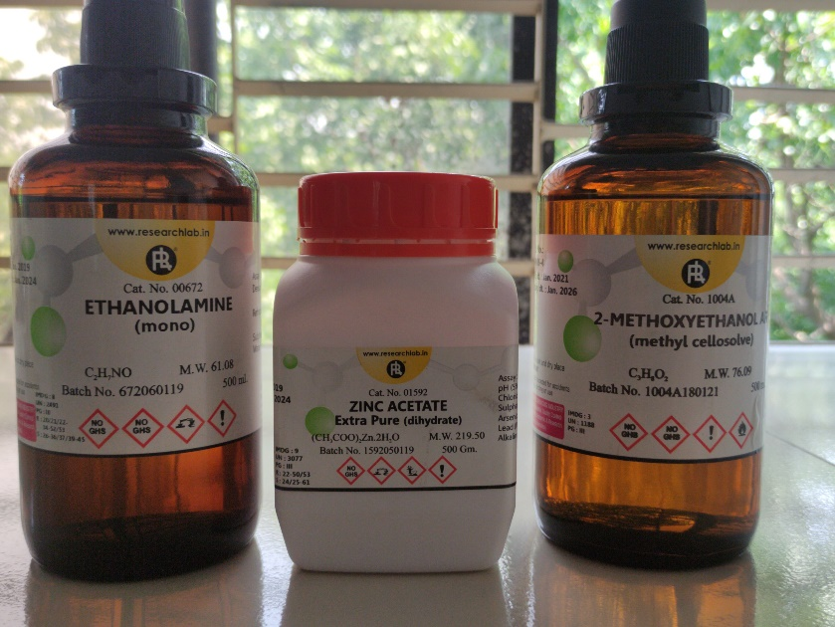
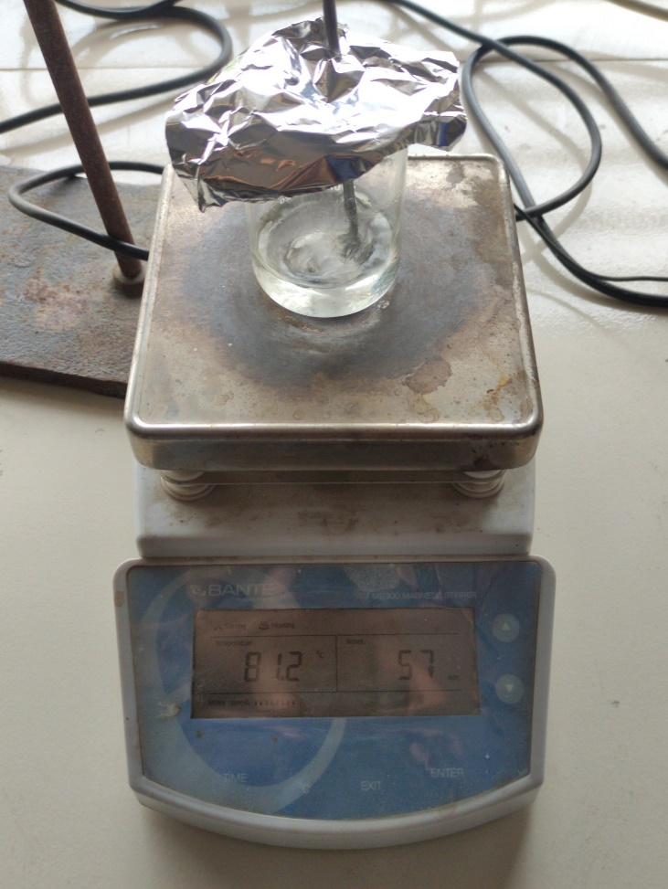
Methodology
Raw Materials
Stirring (80° C)
Fig. 2: Solution Preparation

Slide 10
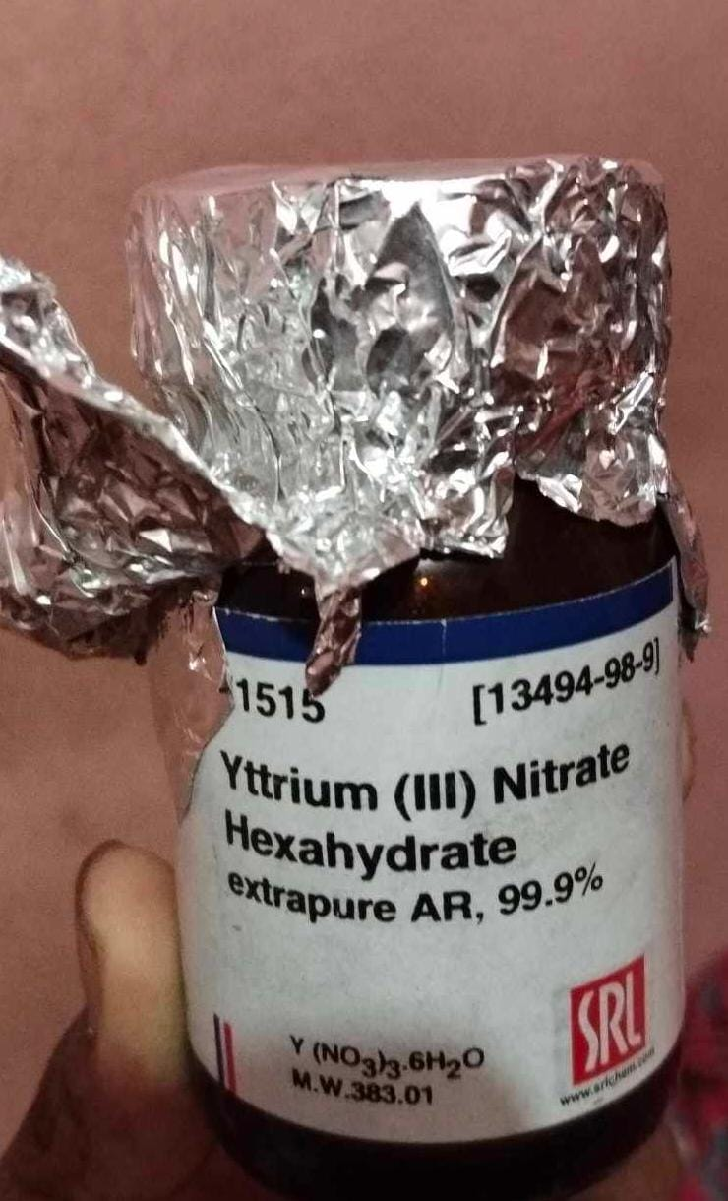
Methodology
Fig. 3: Doping Material

Slide 11
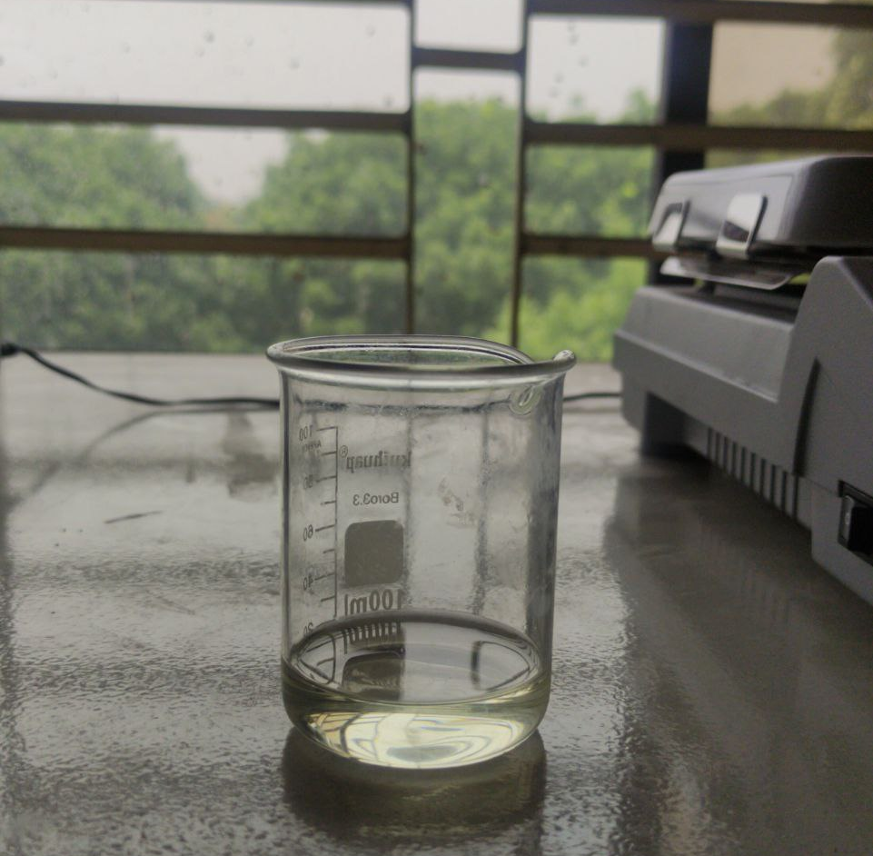
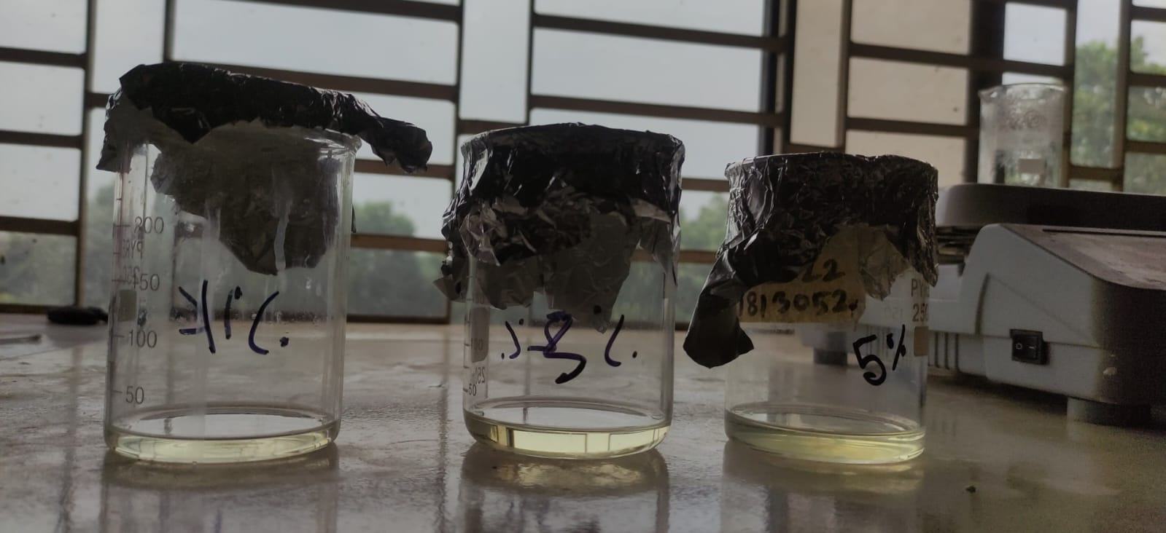
Methodology
Pure ZnO
1% YZO, 3% YZO, 5% YZO
Fig. 4: Precursors

Slide 12
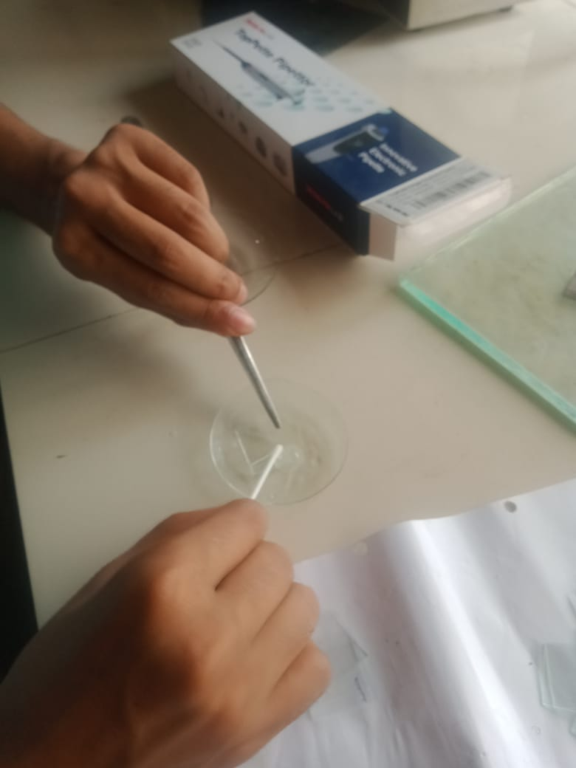
Methodology
Manual Cleaning
Ultrasonic Cleaning
Fig. 5: Glass Preparation

Slide 13
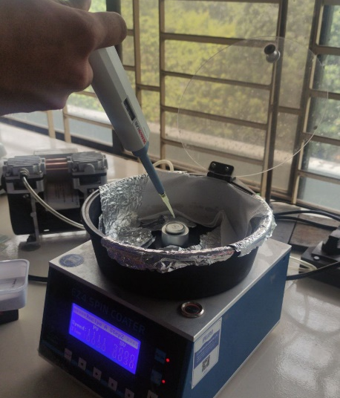
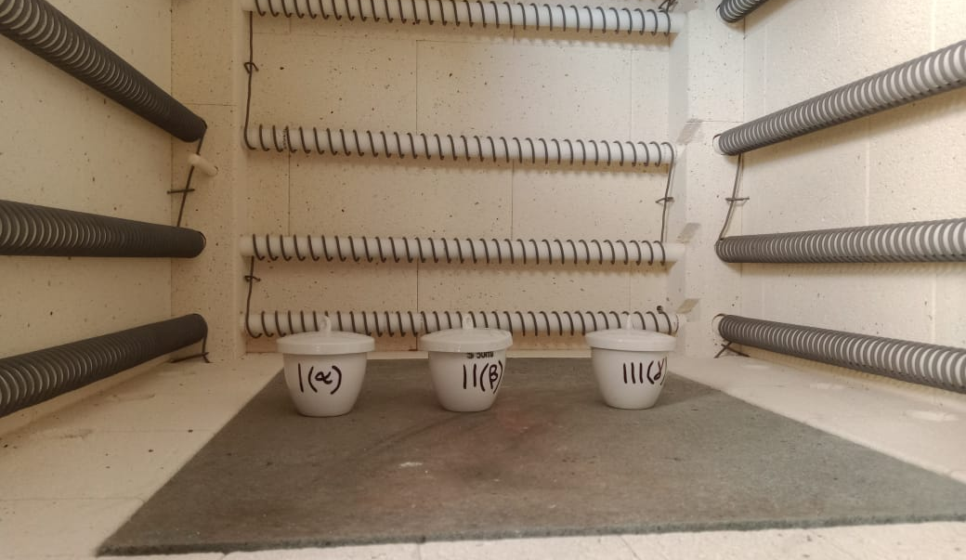
Methodology
Spin Coating
Annealing
Fig.6: Coating & Annealing

Slide 14
Deposition Techniques
Vacuum Based
Solution Based
Printing
Electrode Deposition
Chemical Vapor Deposition
Evaporation Deposition
Spin Coating
Sputtering
Colloidal Synthesis
Plasma Enhance CVD (PECVD)
Thermal Evaporation
Layer by Layer Synthesis
Low Pressure CVD (LPCVD)
Electron Beam Evaporation
Pulse Laser Deposition
Metal Organic CVD (MOCVD)
Molecular Beam Epitaxy
Atomic Layer Deposition

Slide 15
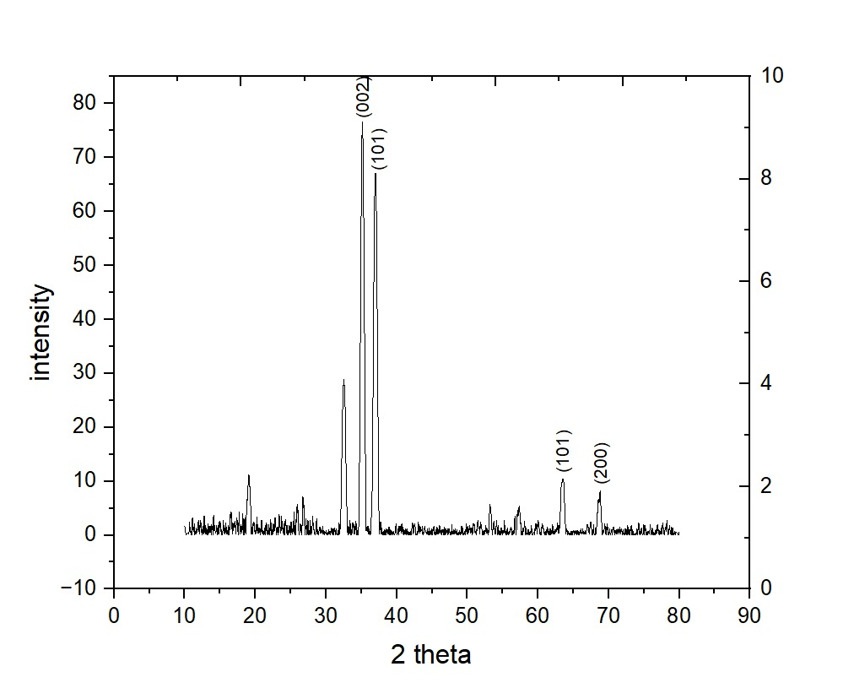
X-Ray Diffraction(XRD)
Fig. 7: XRD result of pure ZnO

Slide 16
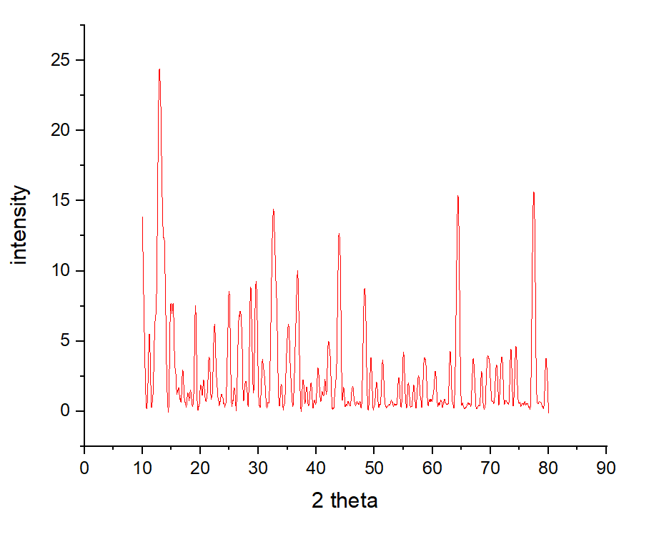
X-Ray Diffraction(XRD)
Fig. 8: XRD result of 1% YZO

Slide 17
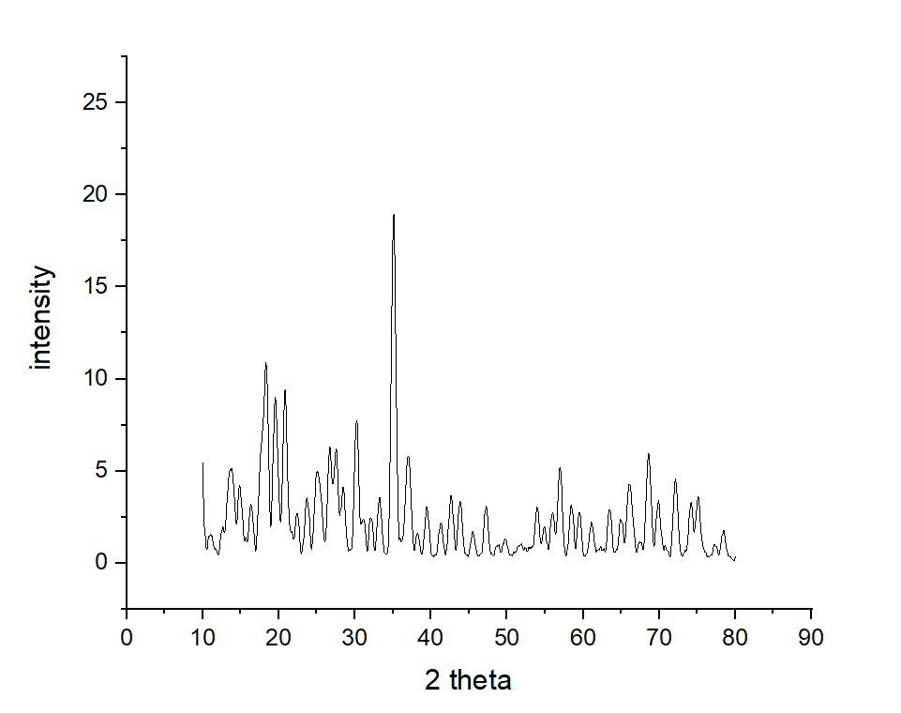
X-Ray Diffraction(XRD)
Fig. 9: XRD result of 3% YZO

Slide 18
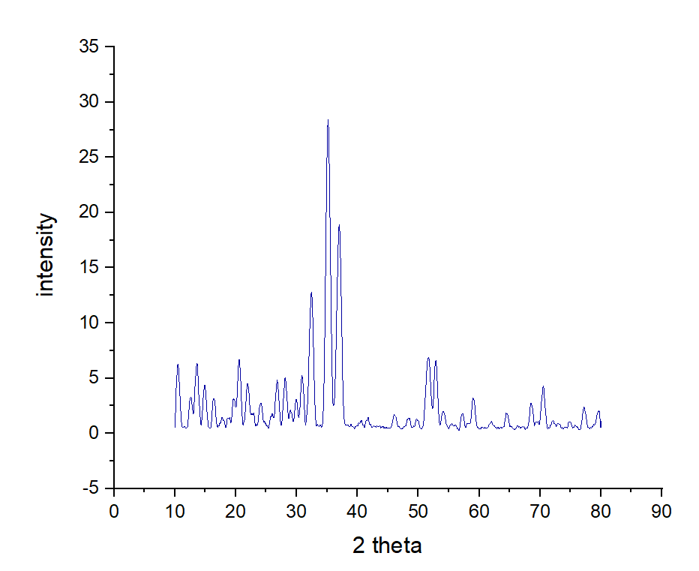
X-Ray Diffraction(XRD)
Fig. 10: XRD result of 3% YZO

Slide 19
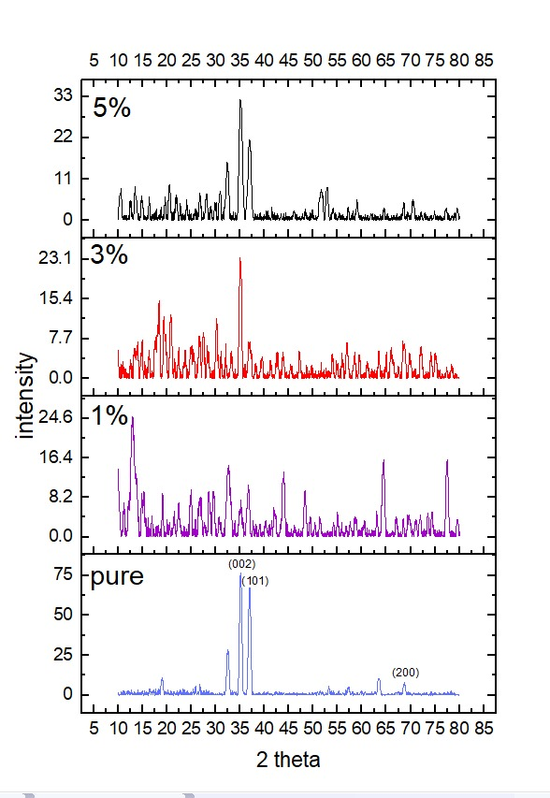
X-Ray Diffraction(XRD)
Fig. 11: XRD result comparisons

Slide 20
X-Ray Diffraction(XRD)
hkl | 2θ
 | ZnO Wurtzite Structure | Pure ZnO | 1% YZO | 3% YZO | 5% YZO
(002) | 34.228 |  | 34.327 | 34.411 | 34.536
(100) | 31.749 | 32.138 |  | 30.248 | 31.889
(101) | 36.257 | 35.903 | 36.427 |  | 36.384
(102) | 47.257 |  | 48.348
(110) | 56.535 |  |  | 56.841
(200) | 63.341 | 63.846
Table 1: XRD results for wurtzite ZnO for all examined samples.

Slide 21
Table 2: Lattice parameters analysis
Parameters | Sample
 | Pure ZnO | 1% YZO | 3% YZO | 5% YZO
D (nm) | 18.822 | 12.319 | 18.338 | 13.764
a (Å) | 3.342 | 3.871 | 3.273 | 3.234
c (Å) | 5.273 | 5.323 | 5.242 | 5.223
c/a | 1.577 | 1.374 | 1.602 | 1.616
d₀₀₂ (Å) | 2.55 | 6.7 | 2.56 | 2.51
V (Å³) | 51.033 | 69.077 | 48.632 | 47.307
Density (g/cm³) | 5.295 | 3.912 | 5.556 | 5.712
Dislocation density * 10⁵ lines/m² | 2.82 | 6.59 | 2.97 | 5.28
Strain (ɛ) *10⁻³ | 3.874 | 4.472 | 3.931 | 4.375

Slide 22
Scanning Electron Micrographs(SEM)
Surface morphological studies of the un-doped/Pure ZnO and doped with 1%Y(Yttrium), 3%Y and 5%Y ZnO thin films have been carried out from SEM. The finding’s are as follows:
absence of cracks is observed on large areas of all films;
homogeneous distribution of connected nanoparticles over the surface, mostly hexagonal in shape;
for Y of 3 at.%, the grains are closely packed, and the surface seems to be most uniform among the samples;
lower particle sizes are measured for the un-doped and 5 at.% at Y samples;
it is evident that the porous structure and visibly lower homogeneity in morphology occurred throughout the film formulated with 5 at.% of Y;

Slide 23
Scanning Electron Micrographs(SEM) Cont…
Pure ZnO
1%Y doped ZnO
Fig. 12(a): SEM of Pure ZnO, and 1%Y doped ZnO.

Slide 24
Scanning Electron Micrographs(SEM) Cont….
3%Y doped ZnO
5%Y doped ZnO
Fig. 12(b):SEM of 3%Y doped ZnO, and 5%Y doped ZnO.

Slide 25
Energy Dispersion Spectrum (EDS)
To check the chemical composition of the film, an energy dispersion spectroscopy analysis was performed.
it was observed that the film is only composed of zinc and oxygen for pure ZnO;
the spectrum confirms presence of Zn, O and Y elements in the prepared films with their nominal percentage;
the presence of the silicon peak in the spectrum is due to the glass substrate;
the incorporation of Y improves the structural quality of ZnO thin films by altering the crystallite size (D) while changing the micro-strain;

Slide 26
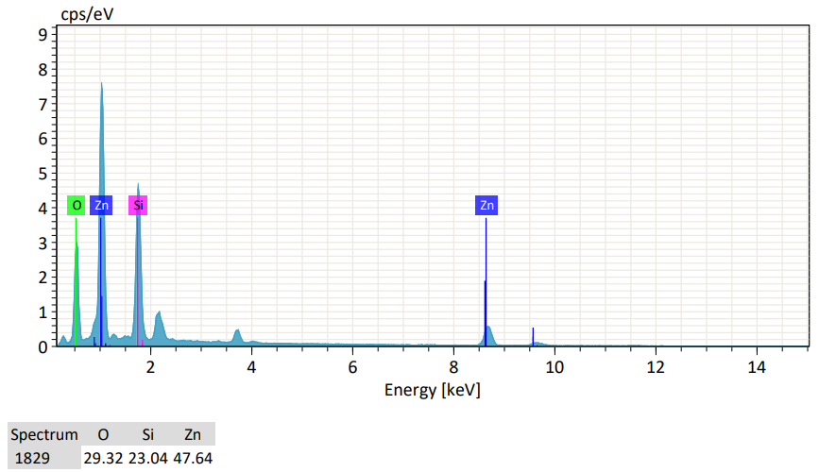
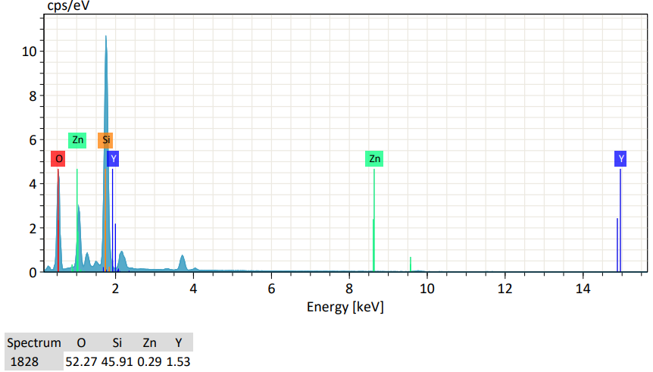
Energy Dispersion Spectrum (EDS) Cont…
Pure ZnO
1%Y doped ZnO
Fig. 13 (a):EDS of pure ZnO, and 1%Y doped ZnO

Slide 27
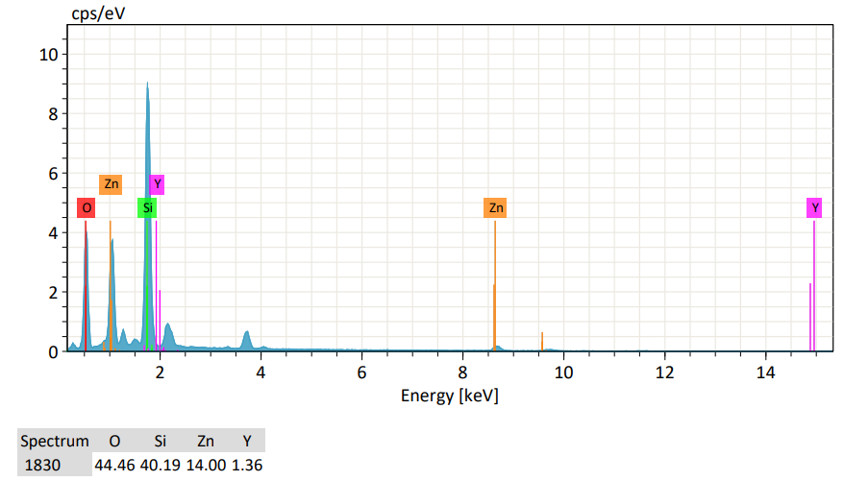
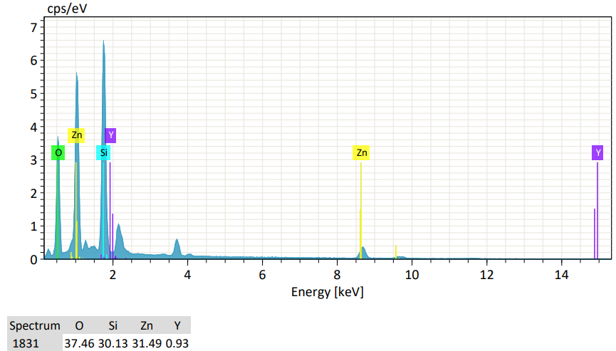
Energy Dispersion Spectrum (EDS) Cont…
3% Y doped ZnO
5% Y doped ZnO
Fig. 13(b):EDS of 3%Y doped ZnO, and 5%Y doped ZnO

Slide 28
UV Visible Spectroscopy
The optical band gaps of the films are calculated from the absorption spectra employing Tauc’s plot as shown in Fig. below.
When compared to pure ZnO, the optical band gap for 1, 3 and 5 at % is dramatically decreased (E_{g} = 3.22, 3.19, 3.11 and 3.05 eV, respectively).

Slide 29
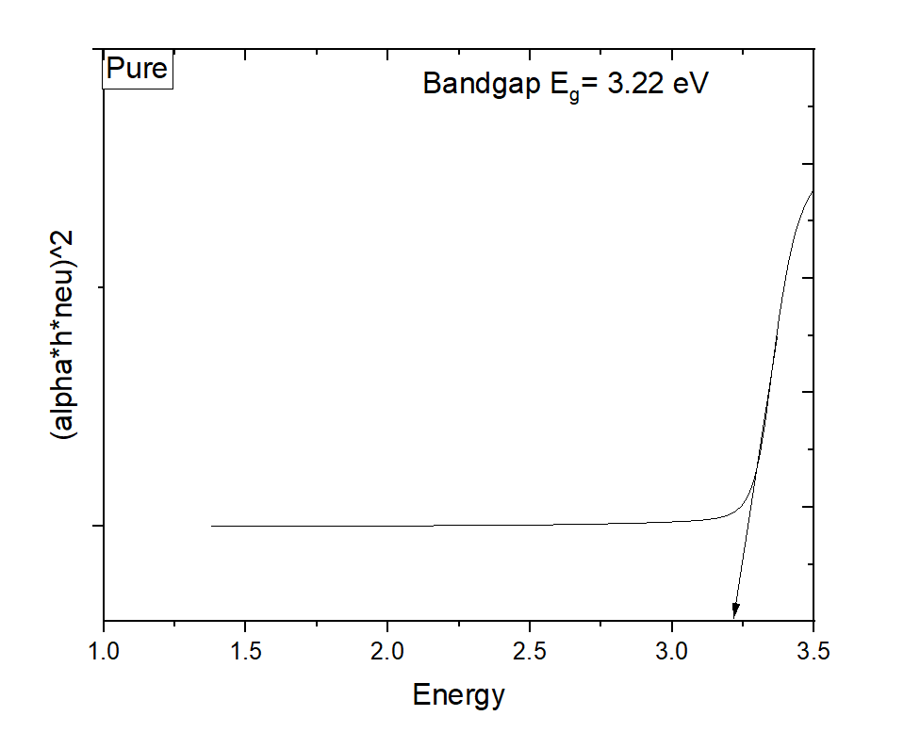
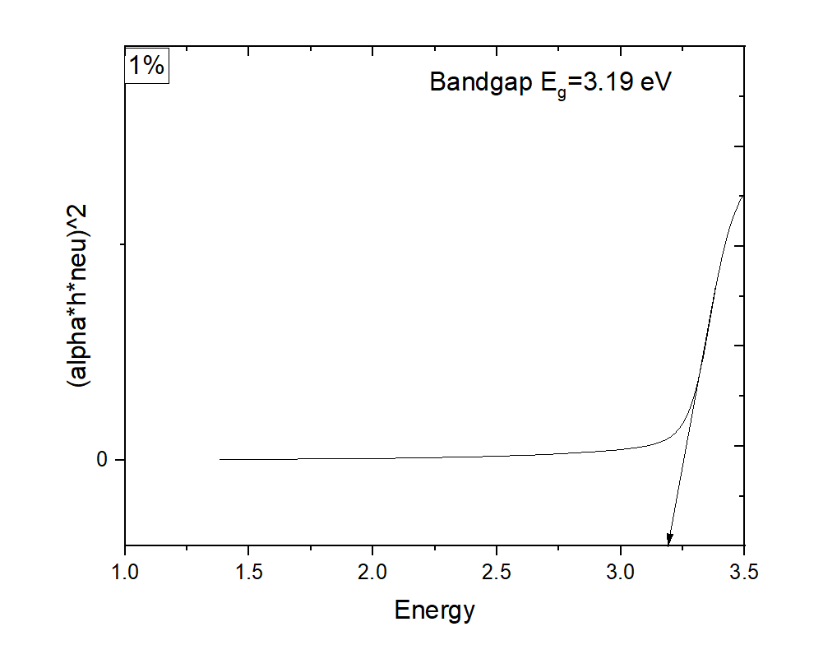
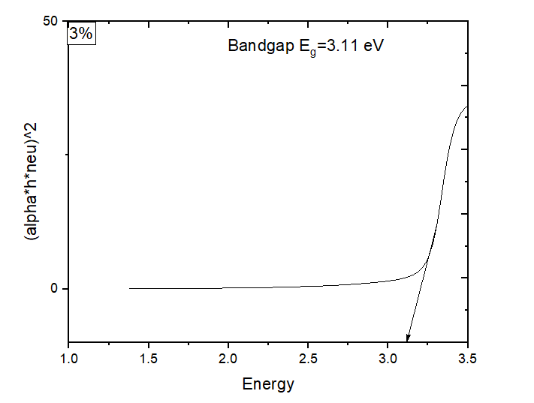
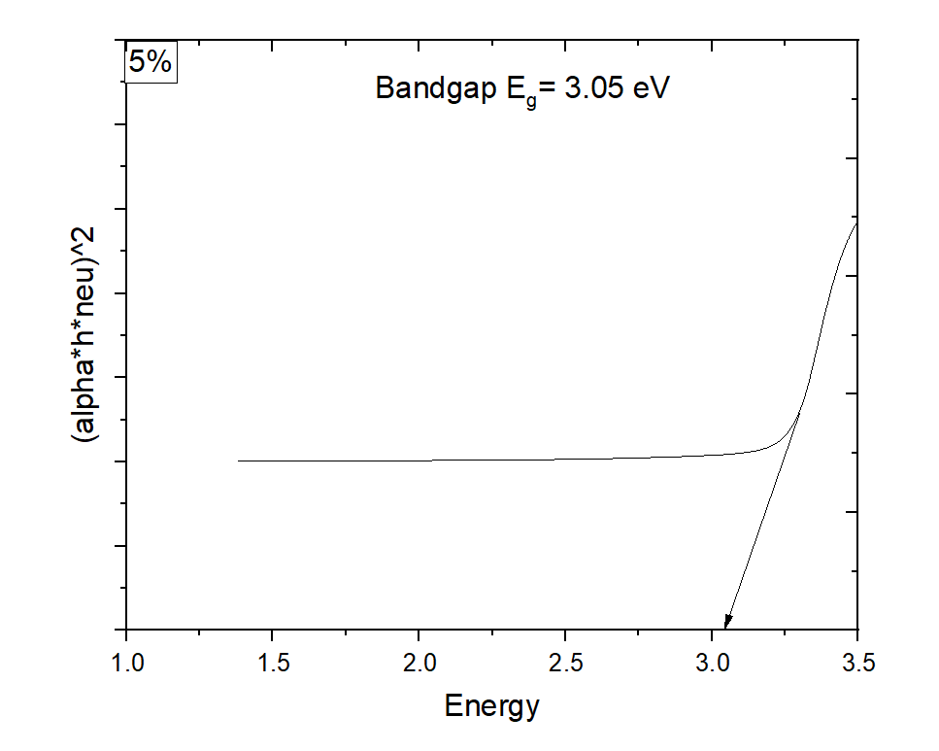
UV Visible Spectroscopy
Fig. 14 : Plot of (𝛼ℎ𝜐)² versus incident photon energy (h𝜐) for Pure ZnO, 1%Y doped , 3% Y doped and 5 % Y doped films.

Slide 30
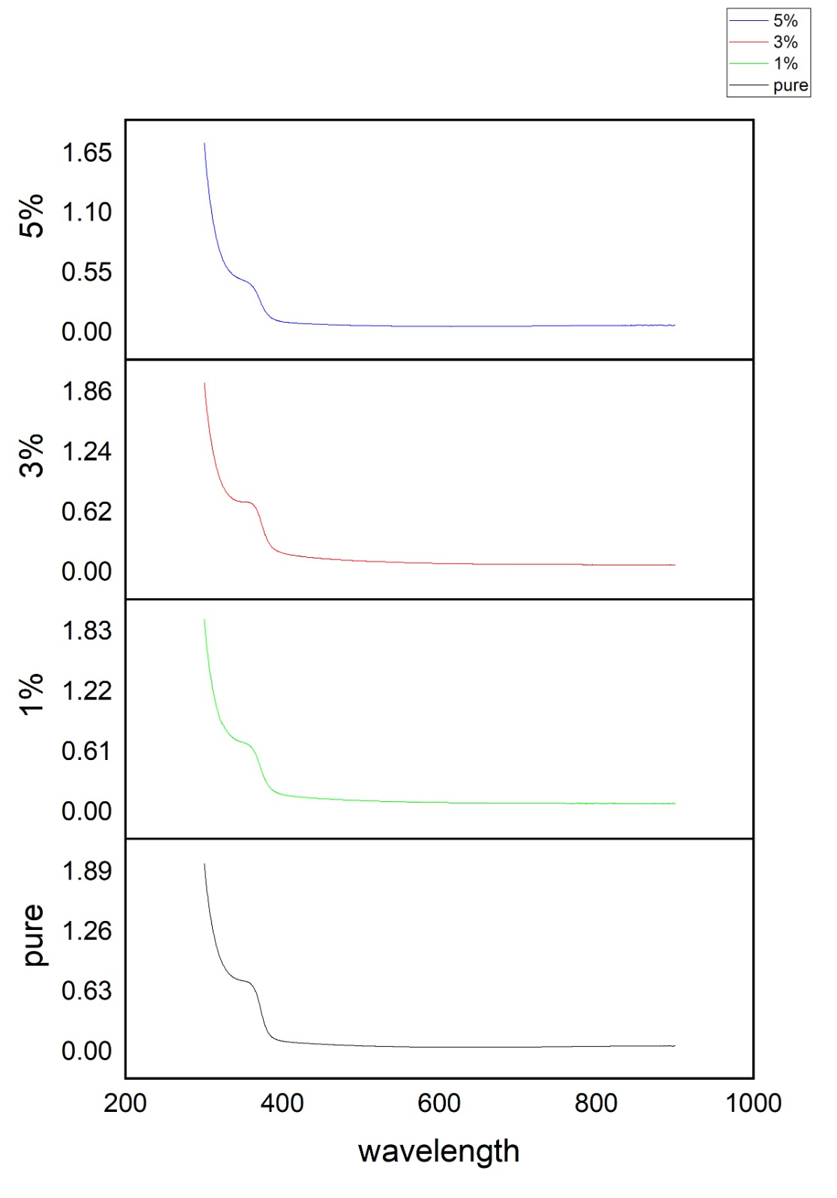
UV Visible Spectroscopy Cont…
The percentage absorbance versus wavelength curve for Yttrium-doped zinc oxide (YZO) thin films would display how the substance absorbs light at various wavelengths over the UV- visible range.
By increasing the concentration of n- type carriers( donor’s, Y³⁺ ) through doping, the band gap is reduced and the absorption edge occurs at considerably higher wavelengths than in intrinsic materials. This is the well-known as Burstein–Moss effect.
Fig. 15: UV-vis absorption spectrum of Pure ZnO and Yttrium doped at 1%,3% and 5% with ZnO.

Slide 31
Conclusions
Spin coating is an easy synthesis process to tackle the difficulty of precursor solution because the solute dissolves completely in the solvent.
Due to the low ionization energy of Y, high quality YZO films were obtained despite of the low temperature growth process.
Pure and Y-doped ZnO were successfully deposited on a glass-preheated substrate at 500 0^{C} by a spin coating method.

Slide 32
Conclusions Cont…
The study's key conclusions can be summarized as follows:
The X-ray diffraction spectrum was indicated that the film has the polycrystalline in nature with a hexagonal wurtzite structure and showed preferred ZnO (002) orientation.
SEM images of the films showed different micro-structures with nanoclusters. The surface was strongly influenced by Y doping with ZnO films and observed a reduction in surface roughness.
The energy band gap of ZnO thin films calculated from the UV absorption spectra is about 3.22-3.05 eV.
The EDS confirmed the presence of Zn, O and Y elements in the prepared films.

Slide 33
Recommendations
The following suggestions can be used to improve the qualities:
Preparing a precursor solution with high purity;
Controlling the spin-coating parameters(duration, speed) appropriately;
Prepare the substrate before deposition to make sure the substrate is cleaned and free of impurities ;
To ensure consistent film deposition, optimize the spin-coating parameters ;
It should be make sure the Yttrium dopants are distributed uniformly throughout the film. To avoid segregation, it should be needed to stir the precursor solution;
The controlled annealing and drying procedures should be used to drive crystallization and eliminate solvents;

Slide 34
References
Y.-S. Kim, W.-P. Tai, Appl. Surf. Sci. 253 (2007) 4911.
Y. Lee, C. Lee, E. Shim, E. Jung, J. Lee, D.Y. Kim, S. Lee, D. Fu, H.D. Yoon, J. Korean Phys.
Soc. 59 (2011) 2774.
3. F. Bertram, S. Giemsch, D. Forster, J. Christen, R. Kling, C. Kirchner, A. Waag, Appl.
Phys. Lett. 88 (2006) 061915.
4. C.-L. Tsai, M.-S. Wang, Y.-H. Chen, H.-C. Chang, C.-J. Liu, C.-T. Lee, Y.-T. Shih, H.-J.
Huang, Y.-J. Lin, J. Appl. Phys. 107 (2010) 113717.

